Slide 1
SOFTWARE ENGINEERING (15B11CI513 ) Credits :- 4 Contact Hours :- 3-1-0 Lecture 2: Software Process Model

Slide 2
Software Process
(IEEE) A sequence of steps (activities, methods, practices, and transformations) performed for a given purpose (develop and maintain software)
Steps:
Specification
Design and Implementation
Validation
Evolution
A “software process model” is an abstract representation of a process.
It presents a description of a process from some particular perspective

Slide 3
Software Process Model
A Model has different Processes in it.
It is followed to produce high quality software.
It provides stability, control, and organization to a process.
They are adapted to meet the needs of software engineers and managers for a specific project.

Slide 4
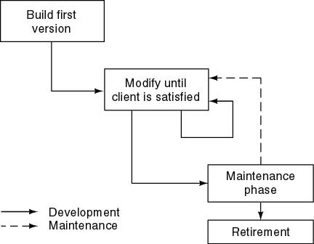
Build and Fix Model
Product is constructed without specification or any attempt at design.
Developers simply build a product that is reworked as many times as necessary to satisfy the client.

Slide 5
Build and Fix Model
The earlier approach
Product is constructed without specification or any attempt at design.
developers simply build a product that is reworked as many times as necessary to satisfy the client.
model may work for small projects but is totally unsatisfactory for products of any reasonable size.
Maintenance is high.
Source of difficulties and deficiencies
impossible to predict
impossible to manage

Slide 6
Why Models are needed?
Symptoms of inadequacy: the software crisis
scheduled time and cost exceeded
user expectations not met
poor quality

Slide 7
Process as a "black box"
Quality?
Uncertain /
Incomplete requirement
In the beginning

Slide 8
Problems
The assumption is that requirements can be fully understood prior to development
Interaction with the customer occurs only at the beginning (requirements) and end (after delivery)
Unfortunately the assumption almost never holds

Slide 9
Process as a "white box"

Slide 10
Advantages
Reduce risks by improving visibility
Allow project changes as the project progresses
based on feedback from the customer

Slide 11
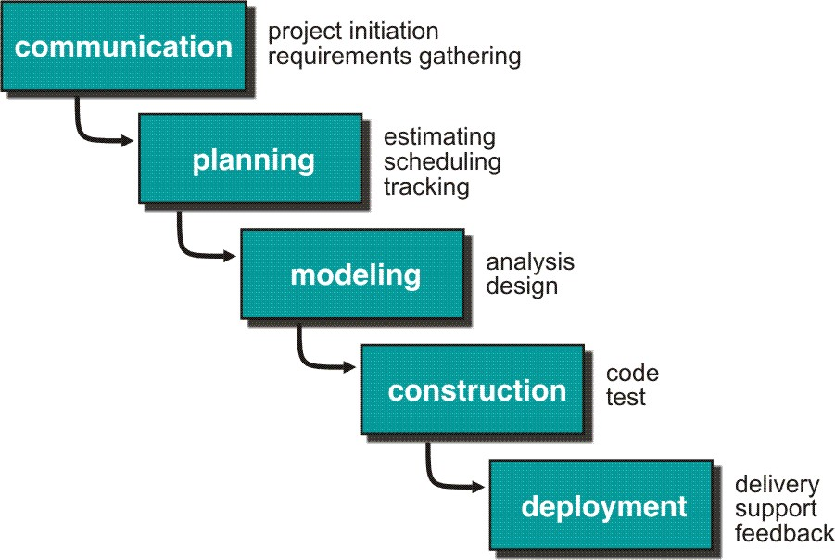
Waterfall Model or Classic Life Cycle

Slide 12
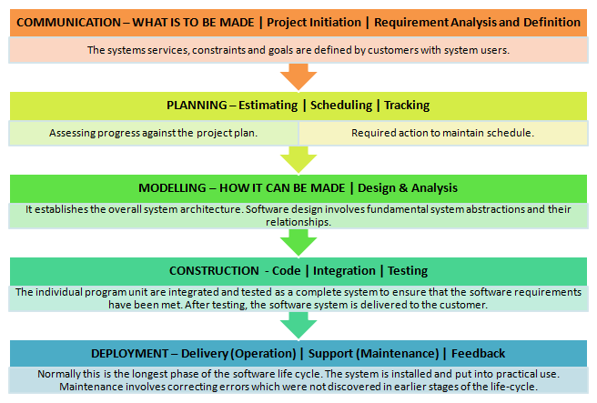
Waterfall Model

Slide 13
Waterfall Model- Limitations
The nature of the requirements could not change during development.
The model implies that you should attempt to complete a given stage before moving on to the next stage
Does not account for the fact that requirements constantly change.
Customers can not use anything until the entire system is complete.
The model implies that once the product is finished, everything else is maintenance.
Surprises/changes at the end are very expensive.
Some teams sit ideal for other teams to finish
Therefore, this model is only appropriate when the requirements are well-understood and changes will be fairly limited during the design process.

Slide 14
Waterfall Model- Limitations
Problems:
Real projects are rarely follow the sequential model.
Difficult for the customer to state all the requirement explicitly.
Assumes patience from customer - working version of program will not available until programs not getting change fully.

